Slide 1

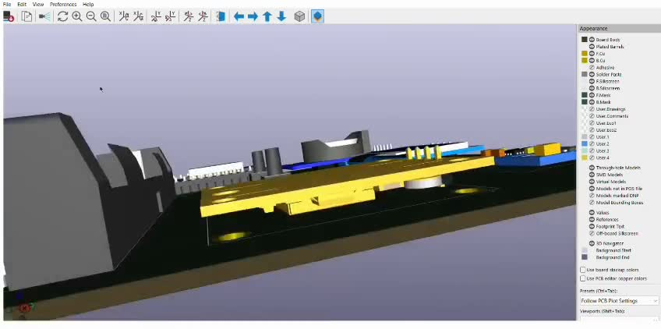
POLARIS
hardware use:ESP32,DS3231 RTS MODULE,NEO-6M GPS MODULE,GY-271 MODULE(MAGNETOMETER),18650 BATTERY,TWO TACTILE SWITCH
ADDITIONAL(TO BE INTEGRATE): CHARGING MODULE

Slide 2
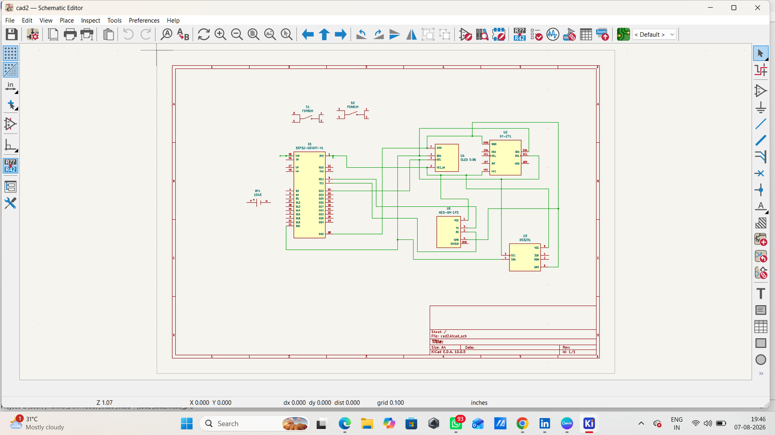
SCHEMATIC

Slide 3
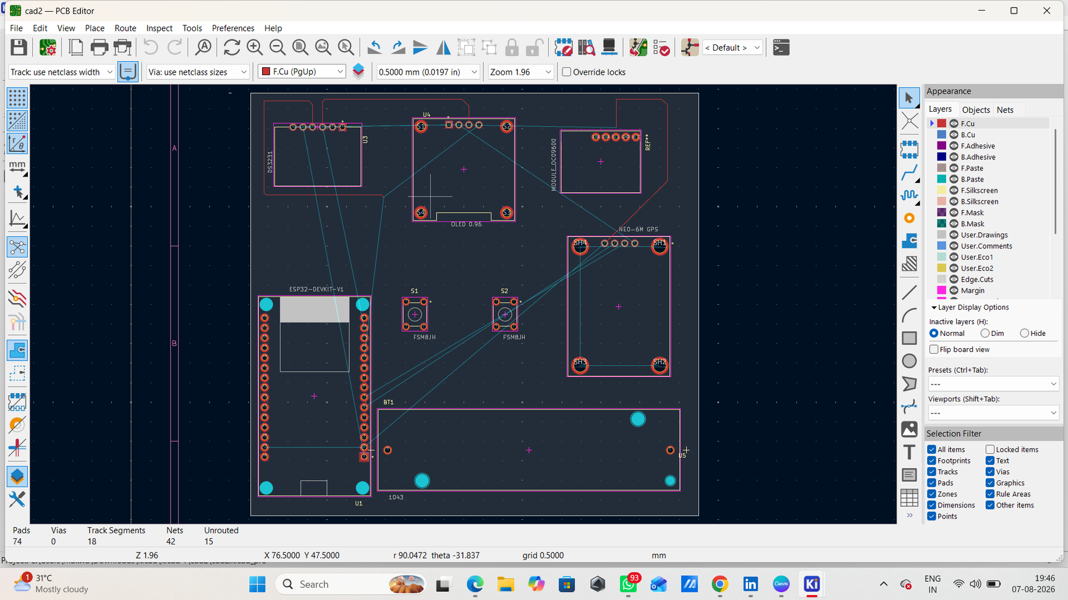
PCB LAYOUT

Slide 4
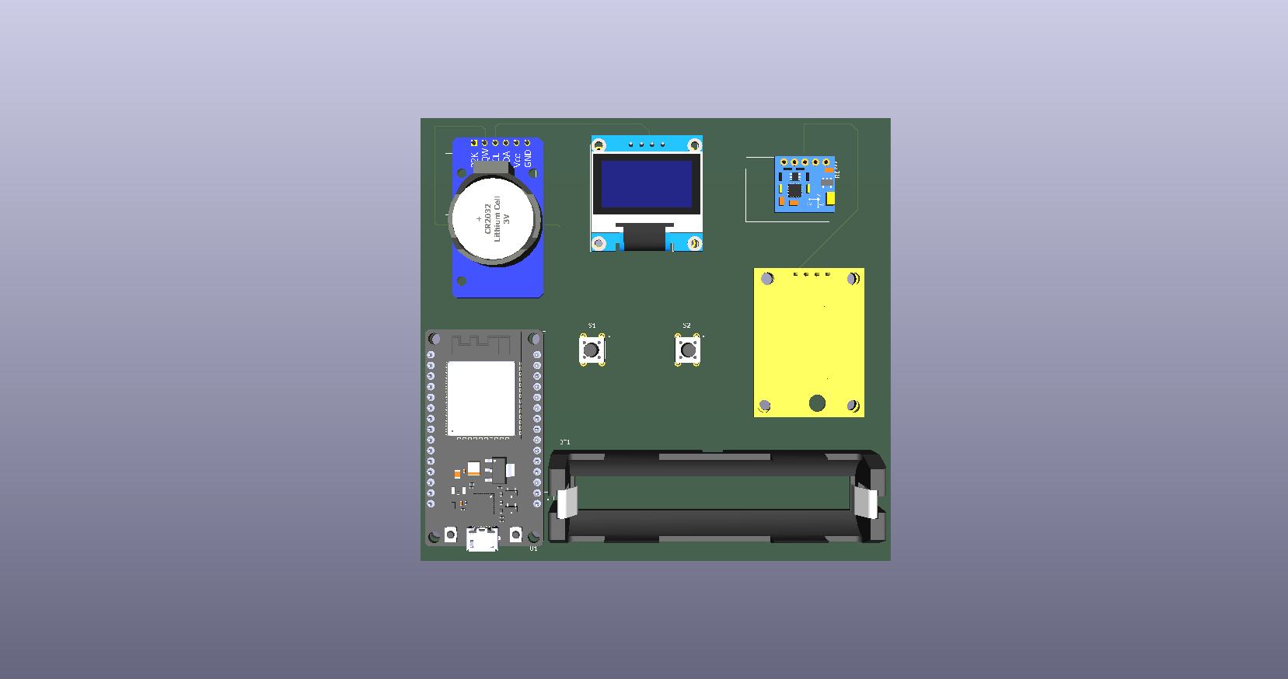
3D PCB VISUALISATION

Slide 5
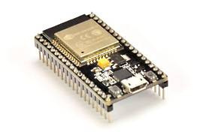
KEY COMPONENTS
ESP32
Main Control Unit
Handles processing, GPIO control, and wireless communication.

Slide 6
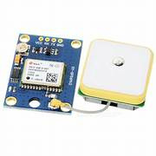
NEO 6M GPS
Provides real-time, GPS coordinates,
including latitude and longitude.

Slide 7
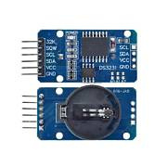
DS3231 RTS
Provides accurate time when
GPS is unavailable.

Slide 8
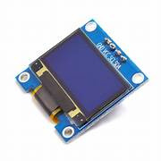
0.96 OLED DISPLAY
Displays Real-Time Time, Date & Direction

Slide 9
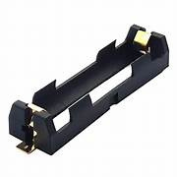
18650 BATTERY HOLDER
Secure Battery Mount & Power Supply

Slide 10
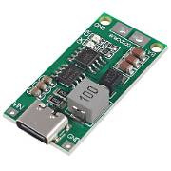
CHARGING MODULE
Safe & Efficient Battery Charging

Slide 11
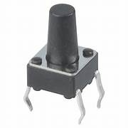
TACTILE SWITCH
Screen Navigation & Control, Used to Navigate Between Screens (Back & Forward)

Slide 12
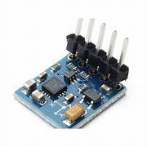
GY-271 (MAGNETOMETER)
The GY-271 is a magnetometer sensor
that detects magnetic fields and
helps determine direction

Slide 13
CONCLUSION
POLARIS is a compact ESP32-based navigation and information system. It combines GPS, a magnetometer, RTC and OLED display to provide direction Real satellite time information. Tactile switches make the system easy to control and navigate. The project demonstrates the integration of multiple sensors into a portable embedded system.

